Slide 1


Developing Accelerators for Homomorphic Encryption
Mehmet Berkay Çatak, Rümeysa Bilik, Efe İzbudak,
Eren Özilgili, Cenker Şahin
Erkay Savaş
August 6, 2024

Slide 2

Outline
Homomorphic Encryption
Examples
Schemes
Advantages
Disadvantages
Research Question
Hardware Acceleration
Our Progress and Aim

Slide 3
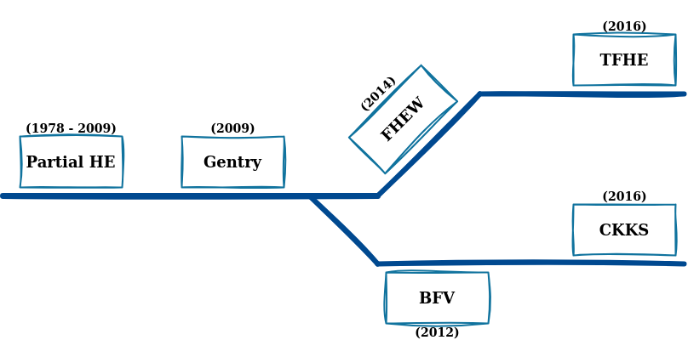
What is Homomorphic Encryption?
Encryption schemes which allow a third-party to perform computation on encrypted data

Slide 4
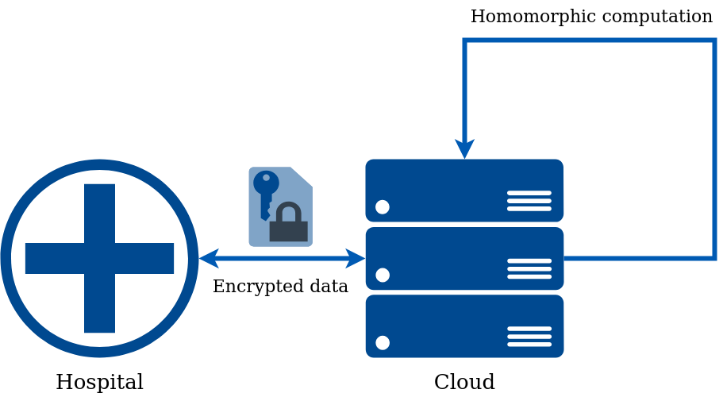
Examples of Homomorphic Encryption
Health Informatics

Slide 5
Examples of Homomorphic Encryption
Health Informatics
Privacy-Preserving Machine Learning

Slide 6
Examples of Homomorphic Encryption
Health Informatics
Privacy-Preserving Machine Learning
Secure Voting Systems

Slide 7
Examples of Homomorphic Encryption
Health Informatics
Privacy-Preserving Machine Learning
Secure Voting Systems
Financial Transactions and Fraud Detection

Slide 8
Advantages of Homomorphic Encryption
Confidential computing

Slide 9
Advantages of Homomorphic Encryption
Confidential computing
Data Monetization

Slide 10
Advantages of Homomorphic Encryption
Confidential computing
Data Monetization
Reduced trust requirements

Slide 11
Advantages of Homomorphic Encryption
Confidential computing
Data Monetization
Reduced trust requirements
Interoperability

Slide 12
Advantages of Homomorphic Encryption
Confidential computing
Data Monetization
Reduced trust requirements
Interoperability
Integrity assurance

Slide 13
Homomorphic Encryption Schemes
CKKS (Cheon-Kim-Kim-Song) (Cheon et al., 2017):
Approximate computation
Leveled encryption scheme
Appropriate for machine learning, scientific computation
TFHE (Fast Fully Homomorphic Encryption over the Torus) (Chillotti et al., 2019):
Exact computation
Fast bootstrapping
General use case

Slide 14
Disadvantages of Homomorphic Encryption
High Computational Cost

Slide 15
Disadvantages of Homomorphic Encryption
High Computational Cost
Performance Overhead

Slide 16
Disadvantages of Homomorphic Encryption
High Computational Cost
Performance Overhead
Complexity of Implementation

Slide 17
Disadvantages of Homomorphic Encryption
High Computational Cost
Performance Overhead
Complexity of Implementation
Increased Data Size

Slide 18
Research Question
How can we accelerate homomorphic encryption?

Slide 19
Hardware Acceleration
Using specialized hardware to perform tasks more efficiently

Slide 20
Hardware Acceleration
Using specialized hardware to perform tasks more efficiently
Three main types:
CUDA
FPGA
ASIC

Slide 21
Our Progress and Aim
Python implementations of homomorphic encryption algorithms
Python wrapper for CUDA HE library
Hardware implementations of algorithms with Verilog

Slide 22
References
Cheon, J. H., Kim, A., Kim, M., & Song, Y. (2017). Homomorphic
encryption for arithmetic of approximate numbers. Advances in
Cryptology – ASIACRYPT 2017, 409–437.
https://doi.org/10.1007/978-3-319-70694-8_15
Chillotti, I., Gama, N., Georgieva, M., & Izabachène, M. (2019).
TFHE: Fast fully homomorphic encryption over the torus. Journal of
Cryptology, 33(1), 34–91.
https://doi.org/10.1007/s00145-019-09319-x

